Slide 1

HYDERABAD EVENT PLAN
PRO KABADDI MANAGEMENT
Professional Sports Event Management Portfolio
PREPARED BY
Nithin Pillalamarri
B.Tech CSE (AI) | Class of 2026

Slide 2


Project Strategic Overview
Primary Objective
Key Planning Pillars
To design and execute a comprehensive Pro Kabaddi League event framework from inception to completion, ensuring elite operational standards.
→
Integrated Venue & Capacity Planning
→
Dynamic Budgeting & Financial Control
→
Vendor Procurement & Management
→
Workforce Deployment & Shift Logic
45 DaysProject Duration
GachibowliSelected Venue
→
On-Ground Match Day Operations
→
Proactive Risk Management Protocols

Slide 3
Event Core Particulars
Match | Telugu Titans vs Bengaluru Bulls
Venue | Gachibowli Indoor Stadium
Audience | 6,500 Spectators
Budget | ₹39.6 Lakhs Total
Staffing | 200 Professional Personnel
Vendors | 10 Specialised Categories

Slide 4









Venue Layout and Flow
Parking
Security
Ticketing
Gate 1 & 2 Access
Multi-tier Scanning
Online/Box Office
Food Court
Seating
Arena
Public Amenities
Zone-wise Entry
FOP Field of Play
Logic: Linear flow ensures zero bottlenecks & safe evacuation.
Medical
Control
Emergency Bay
Event Operations

Slide 5
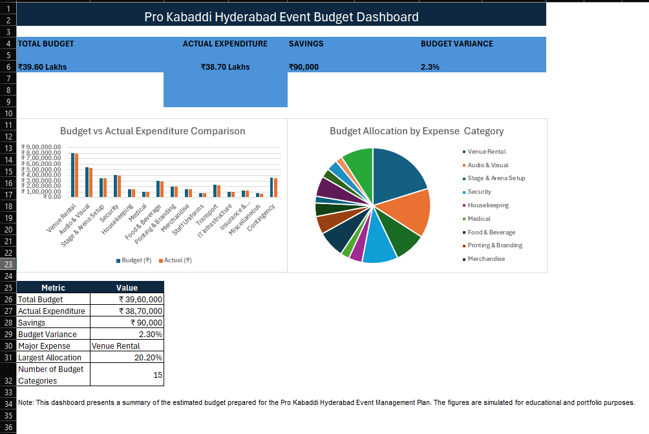

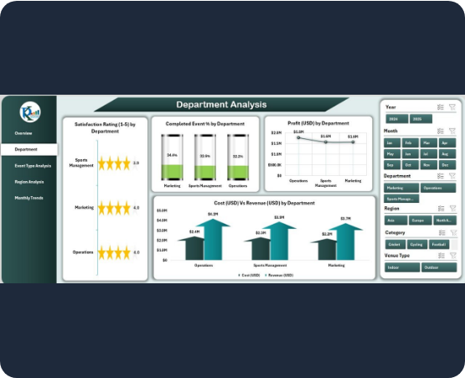


Budget Management Analysis
Financial Highlights
→
Budget strictly maintained within ₹39.6L limits.
→
Real-time cost monitoring via integrated dashboard.
→
Absolute financial transparency for stakeholders.
→
Contingency reserves allocated for critical ops.
₹38.7LActual Expenditure
2.3%Variance

Slide 6

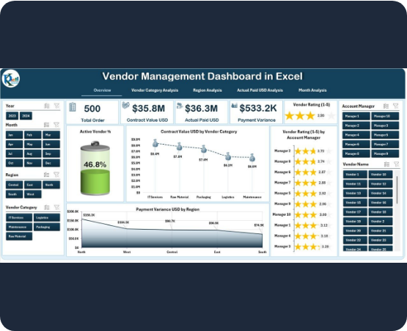

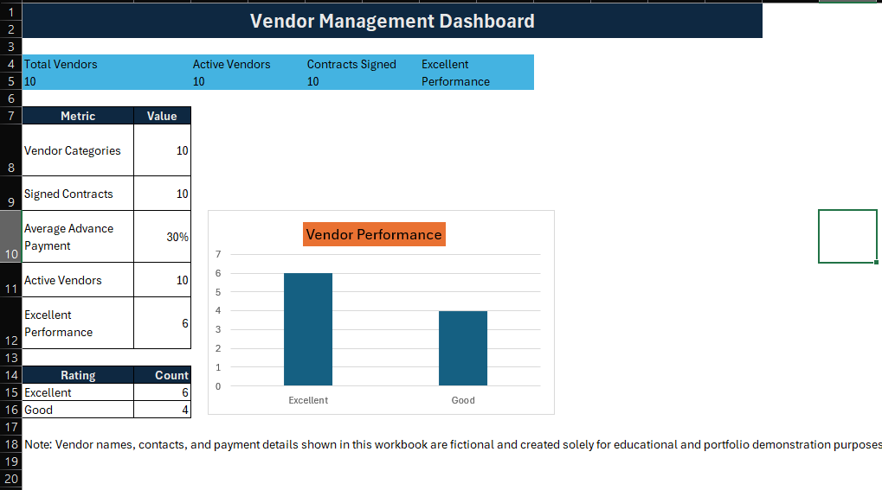
Strategic Vendor Management
Procurement Metrics
→
10 Critical Vendor Categories Managed.
→
End-to-end Contract Lifecycle Monitoring.
→
Rigorous Payment & Advance Tracking.
→
Quarterly Performance Evaluation Scorecards.
Ensuring 100% service level agreement (SLA) compliance for broadcast readiness.

Slide 7
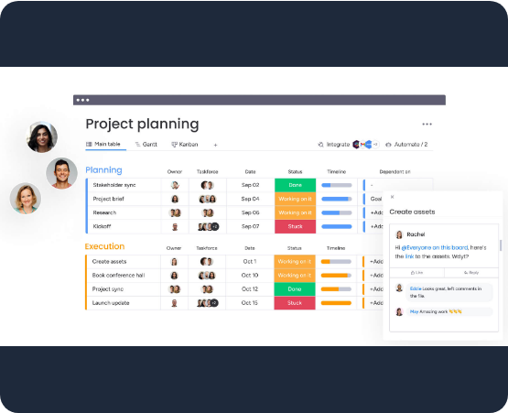
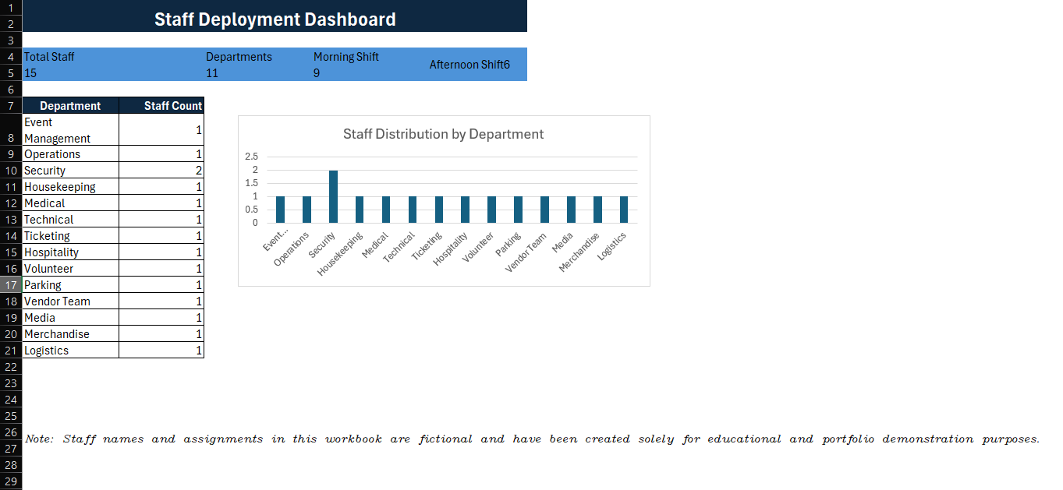

Workforce Deployment Plan
Deployment Logic
→
200 Professional Personnel deployed across zones.
→
11 Specialised Departments (Security to Medical).
→
Optimised Morning & Afternoon shift rotations.
→
Geo-fenced Zone-wise Allocation for accountability.

Slide 8
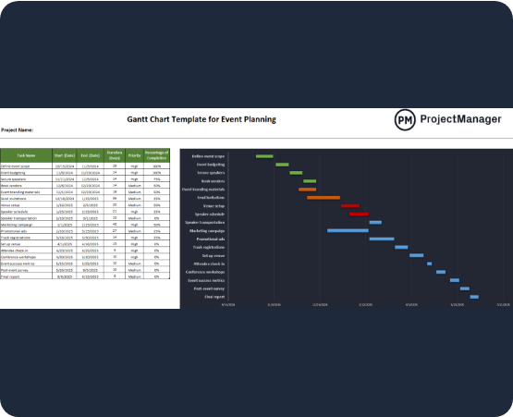
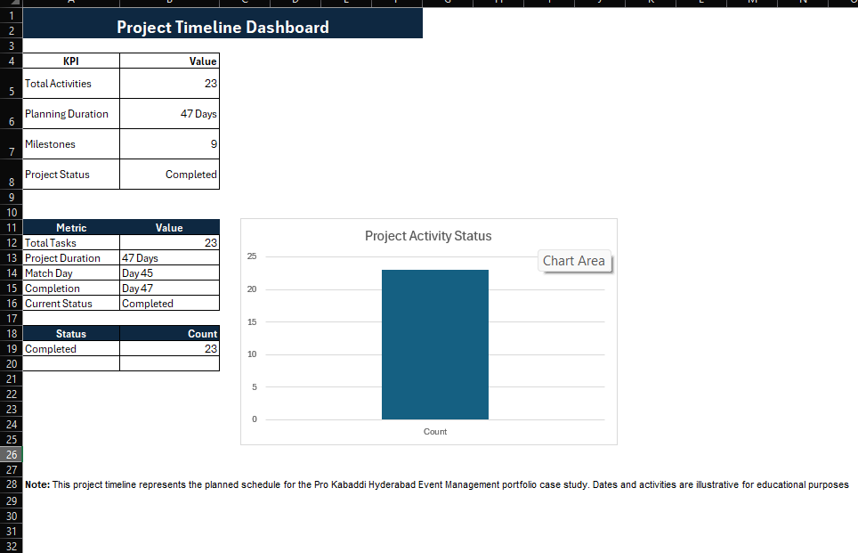
Project Roadmap and Timeline
47-Day Critical Path
→
Phase 1: Pre-Event Strategic Planning (Day 1-20).
→
Phase 2: Venue Setup & Branding (Day 21-44).
→
Phase 3: Match Day Operations (Day 45).
→
Phase 4: Closure & De-mobilisation (Day 46-47).

Slide 9
Risk Mitigation Strategy
Potential Risk Factor | Mitigation & Solution Strategy
Crowd Surge / Congestion | Advanced Security Tier 3 Deployment & Barrier Logic
Medical Emergencies | On-site Dedicated Ambulance & 10 Medical Stationed Staff
Fire Hazards | Comprehensive Evacuation Plan & SATS Fire Safety Audit
Power Failure | Triple Backup Industrial Generator Integration
Vendor Supply Delay | Pre-vetted Secondary Backup Vendor Contracts

Slide 10











Key Project Deliverables
Strategic Report
Budget Engine
Vendor Tracker
Comprehensive event framework documentation.
Real-time financial variance dashboard.
Centralised procurement & SLA monitor.
Staffing Plan
Gantt Roadmap
Tech Repository
Dynamic workforce deployment matrix.
Day-by-day operational project timeline.
GitHub hosted project data & code.

Slide 11
Professional Key Learnings
Sports Planning: Mastery of high-stakes indoor stadium logistics.
Vendor Dynamics: Managing multi-category service procurement.
Financial Control: Maintaining ₹39.6L budget with < 3% variance.
Ops Excellence: Real-time management of 200+ on-ground staff.
Risk Mitigation: Drafting disaster recovery and backup protocols.
Data Analytics: Creating Excel-driven dashboards for reporting.

Slide 12
THANK YOU
Prepared By: Nithin Pillalamarri
Sports Management Portfolio | 2026

